Slide 1
“The Gang”
Lauren Milne, Crystal Garcia, Kim German, Olivia Sund, Gio Milan, Celia Duncan, April Waldrop
Notes:
OLIVIA

Slide 2
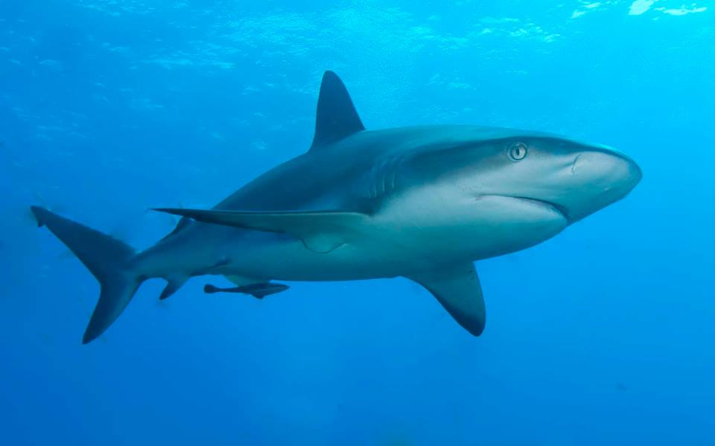
Group Intentions
Create a FAQ page
Comfort & Confidence
Visual examples
Functional small group
Notes:
OLIVIA
Include answers to questions students entering college may not think about
Help first generation college students feel more comfortable and confident about entering college
Learn/become a functional, supportive, working small group

Slide 3
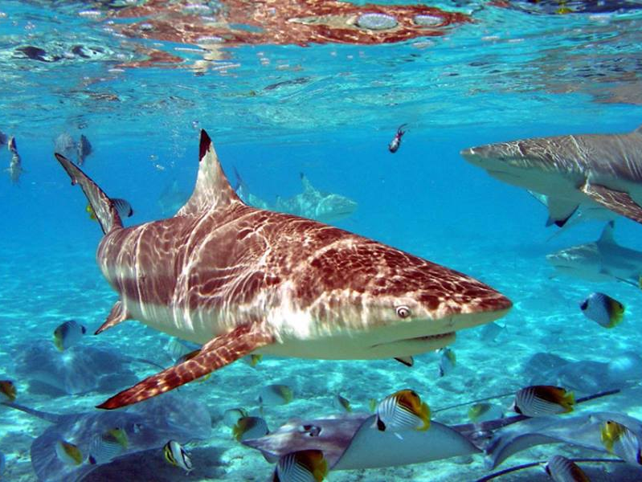
Ad Hoc Committees
Academic Life
Study skills/classes
Groups/clubs
On-campus resources
Notes:
Each group edited each other’s question
APRIL

Slide 4
Ad Hoc: Personal Life
Housing/roommates
Dining/cooking
Personalization/organization
Independent living skills
Notes:
KIM

Slide 5
Small Group Systems
Group Formation
Communication within the group
Decision making
Independent work → Collaborative efforts
Group diversity → stronger end result
Notes:
LAUREN

Slide 6
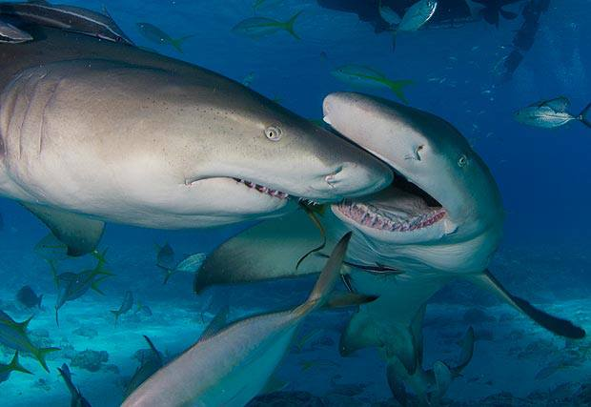
Challenges
Communication
Introverts vs. Extroverts
Motivation
Lack of storming?
Notes:
CRYSTAL

Slide 7
Group Successes
Lack of storming?
Go with the flow mentality
Dedication to producing strong results
Created clear and attainable agendas each week
Notes:
GIO

Slide 8
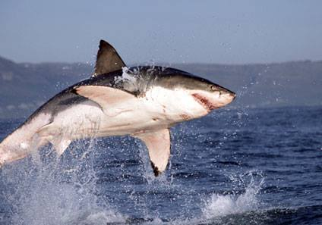
Final Outcome
Google Doc
Pinterest
Tumblr
Cohesive group! ☺
Printable page
Notes:
CELIA
How we complied everything

Slide 9
Any Questions?

