Slide 1
Social Change Event: Priest for Life lawsuit against Obamacare and HHS Mandate
Live Broadcast, February 15th, 2012

Slide 2
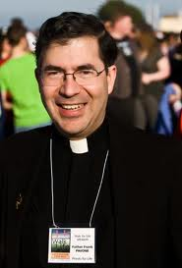
Who are “Priests for Life”?
A Roman Catholic pro-life organization based in New York.
Priests for Life exists primarily in order to show the clergy how to fight what the organization believes to be a culture of death.

Slide 3
Why are they filing the lawsuit?
Believe it is unconstitutional
Violation of the First Amendment
Violation of Religious Liberty/Freedom of Conscience

Slide 4
About the Webcast
Comparing Blunt Amendment to Lawsuit
“Preventative” Health care
How it will affect religious AND/OR Pro-Life Organizations
Upcoming events and opportunities to protest HHS Mandate
LISTEN TO IT HERE: http://instantteleseminar.com/?eventid=26593149

Slide 5
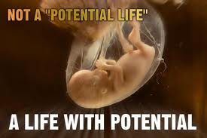
My Reflection

