Slide 1
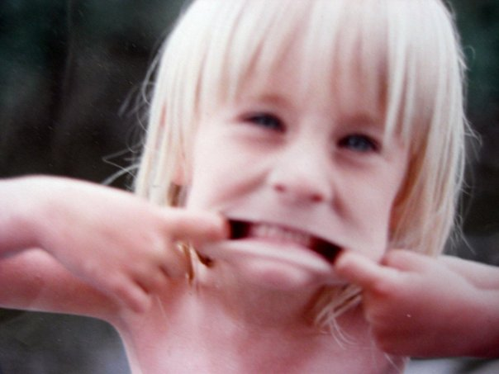
My Social Story
By Lauren Milne

Slide 2
My name is Lauren and I grew up in Monroe, Washington. I come from an Irish, Scottish, and French Catholic background. In my family, I am the third oldest and have three brothers.

Slide 3
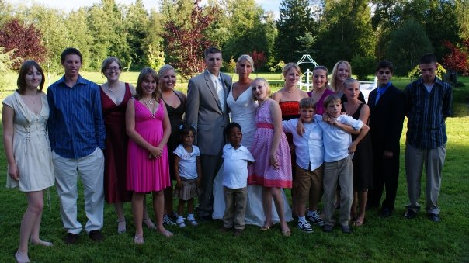
My immediate and extended relatives are very close. They hail from Saskatchewan, Alberta, Washington, and Oregon. Because the majority of my relatives live so close to each other, there is a habit of keeping tabs on one another.
With our cultural upbringing, my family has a tendency to be very proud. And since there are so many proud individuals in one area, my family would compete to have their opinions be heard over each other.

Slide 4
My parents raised me to be subservient to my elders. I had my own pride and opinions, but was trained to hold it all in. As the years went by, I would try to communicate my thoughts and feelings, but would be told that I was being too stubborn and not respectful. So I began to hold everything in.

Slide 5
Because I felt like I had to hold everything in, I had a difficult time speaking with confidence in myself. I might feel confident in what I have to say, but I subconsciously hold that confidence in so that it wouldn’t be taken away.

Slide 6
It’s important to communicate with confidence when I begin my career working with youth because I will not be treated as a professional nor will the children acknowledge me as a leader without it.

Slide 7
When I begin working with youth, I will need to speak authoritatively without hesitation. In order to do this I need to think about what is on my mind, take a deep breath, keep eye contact while speaking, enunciate my words, use a tone of finality, and have a strong posture.

Slide 8
How to Speak with Confidence
1. Think about what I want to say
2. Take a deep breathe
3. Keep eye contact while speaking
4. Enunciate my words
5. Use a tone of finality
6. Have strong posture

Slide 9
When I find myself needing to be more assertive and confident as I speak, I will take a deep breath and think about what I need to say, write down my goal if I have time and communicate my thoughts with a clear, strong voice. It’s important to speak with confidence because, if I don’t, how will I ever be taken seriously?

