Slide 1
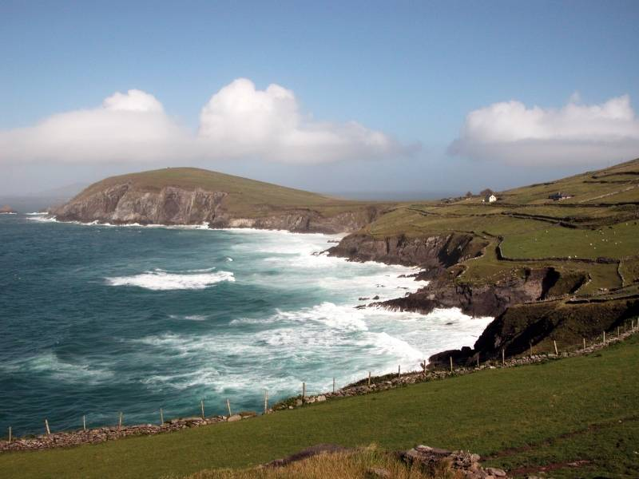
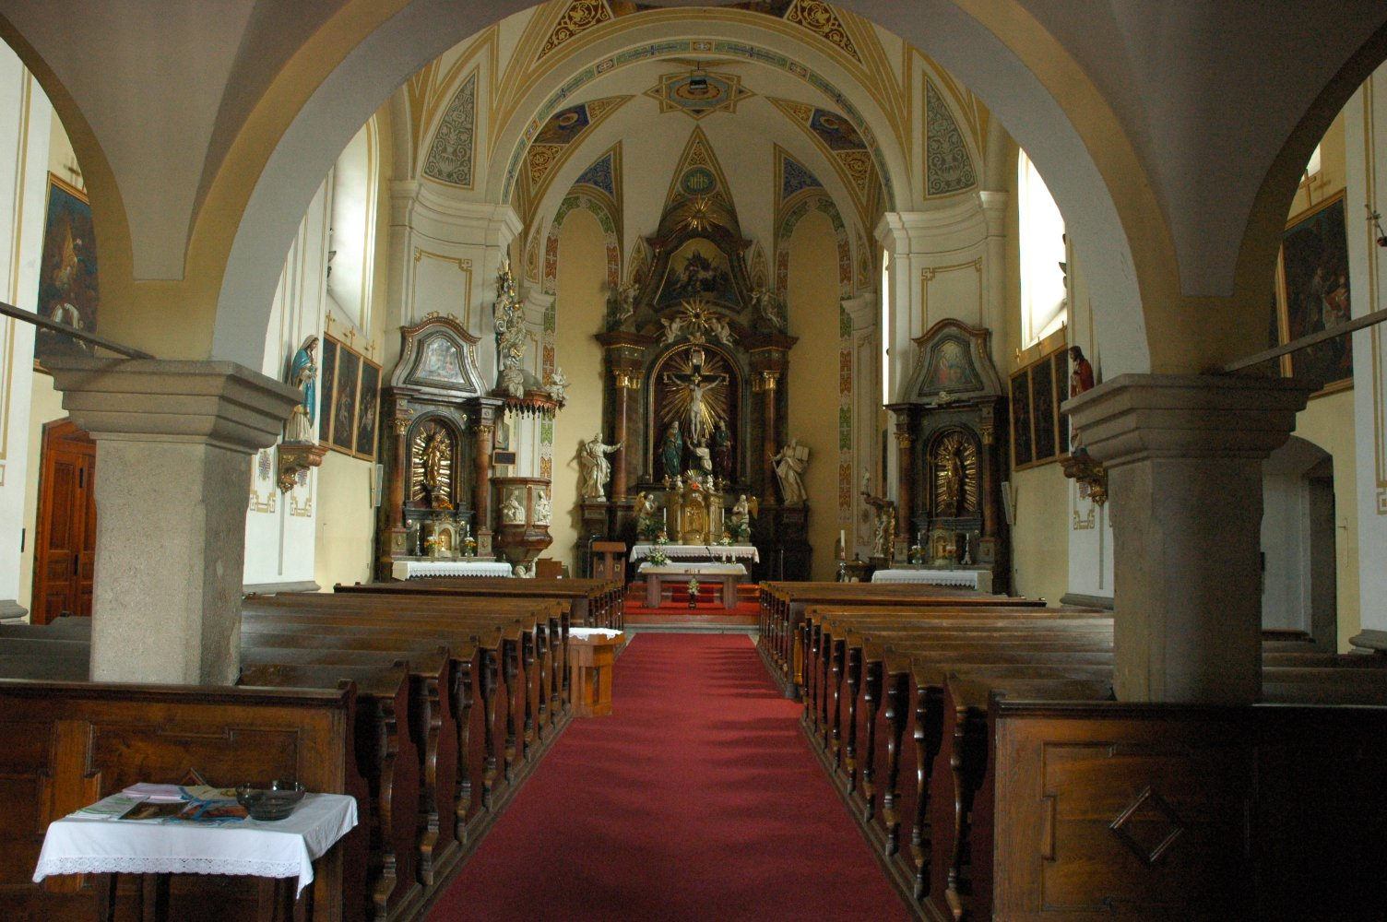
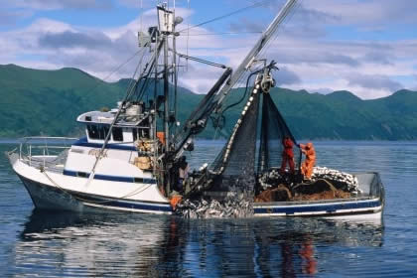
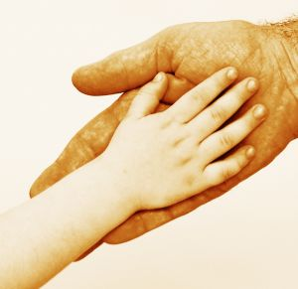
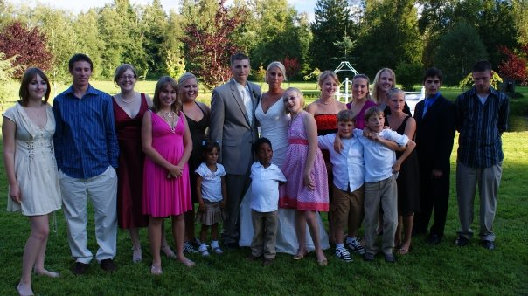
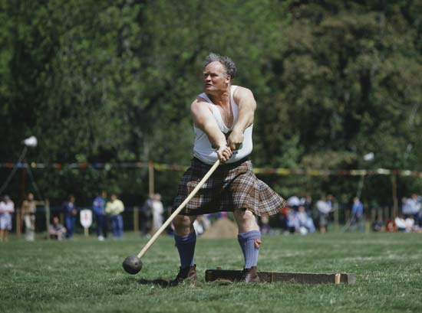
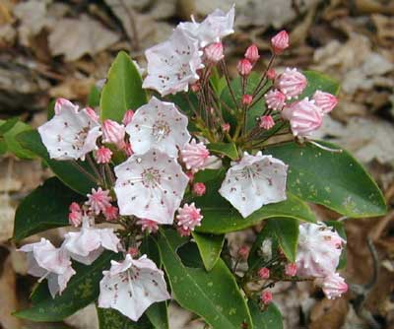
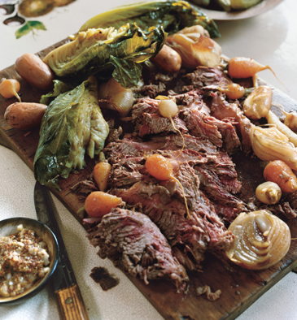
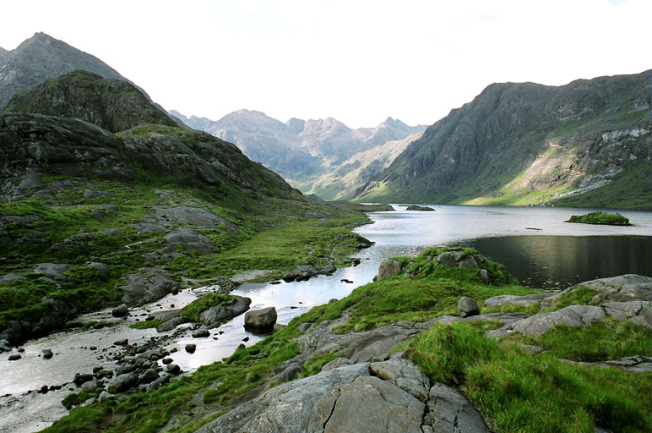
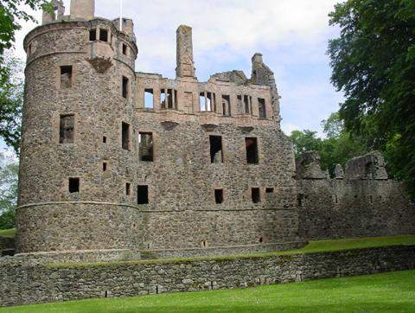
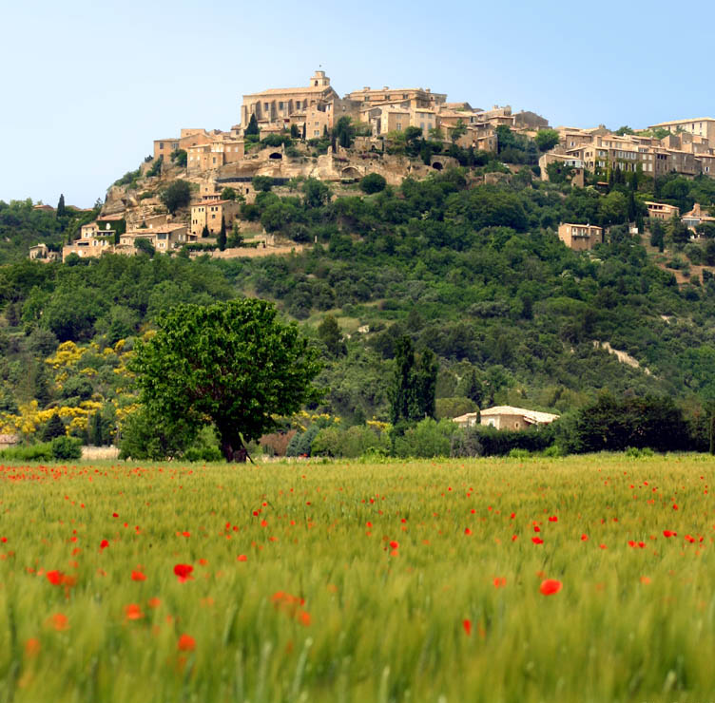
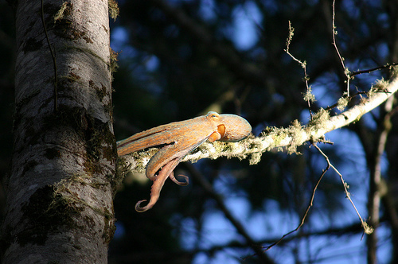
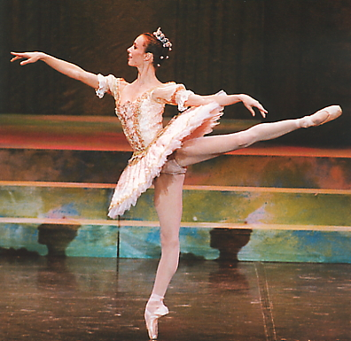
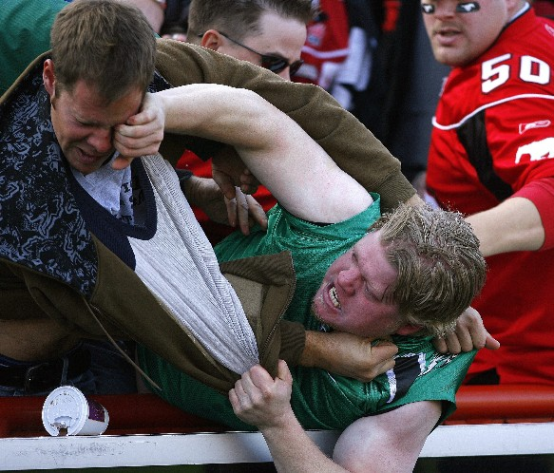
I Am From…
By Lauren Ashley Milne

Slide 2
Is d’ Elrinn me’
(I am from Ireland)
It’s southern, rocky shores.
With Green grass between my toes
and the wind at my back.

Slide 3
I am from Sunday morning mass.
With depictions of the saints all around me
and Latin words striking me deeply
at the center of my soul.

Slide 4
I am from corn beef and cabbage stew,
thick stouts, and potatoes, potatoes,
oh so many potatoes.

Slide 5
Sann a Alba a tha mi
(I am from Scotland)
and it’s “Hundred Acre Woods”
I honor the Gordons—my brothers-in-arms;
my family.

Slide 6
I am from sharp skates gliding across thick ice
and futbol cleats kicking up grassy mounds.
I curl, I toss, I refuse to admit any loss.

Slide 7
I am from the land of giants
where I am but a small dwarf.

Slide 8
Je suis de la France
(I am from France)
The rich culture; the art; the food!

Slide 9
I am from sharp, witty tongues
that never lose a fight.

Slide 10
I am from Sylvie Guillem’s Don Quixote, Claude Monet’s Impressionistic
ponderings, and Victor Hugo’s “Les Miserables”.

Slide 11
I am from the Pacific Northwest,
the Puget Sound, the nature.
Of calming temperate wind that
never fails to loll me to eternal peace.

Slide 12
I am from an overwhelmingly large family.
Three brothers, twenty-eight cousins,
Fifth-teen aunts and uncles, and the
knowledge of sixteen generations extended.

Slide 13
I am from a hardened fisherman, a gold medalist swimmer, a freelance artist, and an educated librarian.
Who taught me about hardship, comradely, and love.

Slide 14
I am from L’ook, Chaas’, Gaat, Chaatl, Teel , and T’a.
(Tlingit Inuit names for Salmon)
From foreign relations across the Pacific Rim.

Slide 15
I am from Mary Colleen Sherry and David Robert Milne,
who, without, I would not exist.
I would not be artistic, worldly, and faithful.
I would not be competitive, stubborn, or proud.
With them, I am me, I am Lauren of the “Laurel Flowers”
With them, I am,
I just AM.

