Slide 1
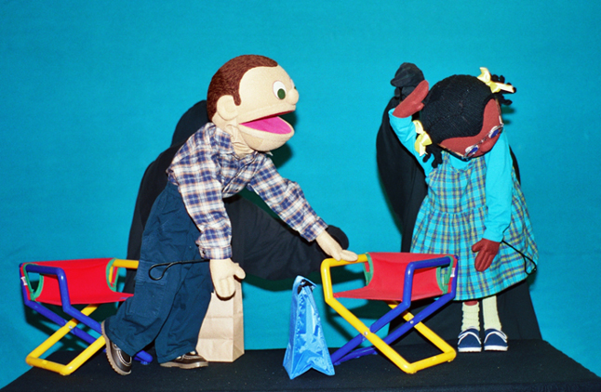
Emotional and Behavioral Disorders
http://www.kotb.com/kob2.htg/ed.htm
Puppets Jimmy Randolph and Melody James from the Kids on the Block Program on Emotional and Behavioral Disorder
By Alicia Anderegg, Holly Costley, Andrea Dekoekkoek, Lauren Milne, Jennifer Rodgers, and John Weston,

Slide 2
What is an Emotional and Behavioral Disorder?
A disability characterized by emotional or behavioral responses in school programs so different from appropriate age, cultural, or ethnic norms that the responses adversely affect educational performance.
Unresponsive to direct intervention in general education, or the condition of the child is such that general education interventions would be insufficient.
http://www.modernmom.com/article/how-do-i-recognize-child-behavior-problems
Behavioral Disorder at work in the classroom

Slide 3
Case History: Brian
Growing up he loved the outdoors and exploring
Had issues in school starting in preschool
Considered a slow learner and got into fights often in school and other social situations
Felt like he was just a bad person
Didn’t feel like he had control over his actions
His parents took concerns for their son’s behavior to his pediatrician
His symptoms, besides his violent and out bursting behavior included night terrors, sleep walking, and seeing auras
Brian diagnosed with temporal lobe epilepsy
Went through many different medications before was put on Tegretol
Began getting better in school and continued to improve in social situations
In sixth grade went to a school that nurtured him and helped him succeed
Encouraged his areas of interest: science, math, nature
In high school underwent EEG biofeedback
Helped Brian regulate his own behavior
Slowly weaned of his medication and continued to improve in behavior
Accepted into California Lutheran University “Plus Program”
Succeeded in ways he was never expected to
Boy with Emotional and Behavioral Disorder
http://www.sarkisfamilypsychiatry.com/conditions/bipolar_disorder.php

Slide 4
Case History: Jordan
Fussy baby- intense, easily upset, doesn’t adjust well
Parents thought she was just fussy and blamed age
Major separation anxiety
Impulsive adolescent- fewer good times and frequent acting out
Felt like nobody understood her
Parents concerned but did not get help yet
At age 17, she was out of control
Fights daily, mood unpredictable, sometimes run away, sometimes separation anxiety, and started self harming habits (cutting)
Parents took her to a doctor
Diagnosed with Bipolar disorder
Medication helped, parents looked for ways to help with disorder
Bipolar didn’t quite fit her symptoms
Jordan found BPD online and sympoms fit perfectly
Went to expert and was diagnosed
Medication and therapy reduced symptoms
Age 23, most present
No longer self harms
Works a part-time job
Working on managing anger
http://www.livestrong.com/article/250840-disruptive-behavior-in-a-child/
Young girl with Behavioral and Emotional Disorder

Slide 5
Setting the Stage for Strong Standards: Elements of a Safe and Orderly School
Three levels of prevention:
Secondary prevention- Specialized Individual Interventions; Individual Student Systems for students with chronic/intense problem behavior (1-7%).
Primary Prevention- Specialized Group Interventions; At-Risk System for students at-risk for problem behavior (5-15%).
All Students in School- Universal Interventions; School Wide and Classroom System for students without serious problem behavior (80-90%).
Seven Essential Elements to assure that schools are safe and orderly:
1. Enact districtwide
Discipline codes:
Encourage parent, community, and staff support through a range of measures. Use clear and concise language with specific examples of all behav-iors that will result in disciplin-ary action, and consequences. Include consequences for minor misbehaviors. Categor-ize offenses from minor to severe.
2. Teach students how to follow the discipline code and ensure that the code is rigorously enforced:
Teach the code and enforce it, while obtaining a consistent application everywhere to everyone in the school system. Provide resources to promote enforcement of the code. Authorize oversight commit-tees to ensure that the code is enforced.
3. Implement effective class-
room management practices:
“A teacher who has mastered classroom management skills keeps students constructively engaged and learning from the moment they enter the room until the time they leave.”
4. Implement programs to modify student misbe-havior:
Such as behavior spe-cialists, who consults with the teacher, reviews school records, observes the stu-dent at work, and develops interventions appropriate for the student.
6. Develop school safety plans:
Developed by each school, encourage open and fre-quent communication be-tween outside agencies and school staff, and practice it.
7. Support the work of families, religious institutions and communities in developing sound character in children:
Through explicitly teaching values to students as a part of the school curriculum.
5. Establish alternative placements which should in-clude “wrap-around” supp-orts for chronically dis-ruptive and violent students:
Continuum of alternatives.

Slide 6
Critical Educational Program Components for Students with Emotional and Behavioral Disorders: Science, Policy, and Practice
Science
-Positive educational outcomes come as a result of appropriate use of effective methods and related strategies; well trained and disciplined professionals; and carefully orchestrated school, home, and community support systems
Policy
- Qualified and committed professionals
-Successful and pragmatic reform
Practice
-Coordinated Community Support Mechanisms
-Utilitarian Environmental Supports
-Effective Behavioral Management Systems
-Valid Social Skill, Interpretation & Interaction Programs
-Proven Academic Support Systems
-Effective Parent & Family Involvement Programs

Slide 7
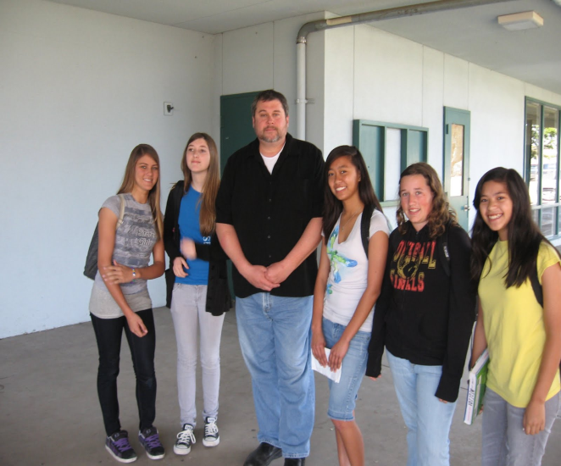
Effective Strategies
Positive Behavior Support
Research has shown that punishing a student for bad behavior is much less effective than rewarding a student for good behavior. Rewards are a bigger factor in motivation, than negative consequences.
ABC Tracking
ABC tracking occurs after any incident when there is an inappropriate behavior. ABC stands for Antecedent Behavior Consequence, tracking these behaviors helps us to find out more about the who, what, when, where and how’s of students behaviors. Writing down the antecedent to a behavior helps us to determine a pattern of possible triggers for a negative behavior. Triggers could be anything from certain times of the day, changes in routine, or interaction with specific individuals.
http://sdusd-newsfeed.blogspot.com/2010/04/promoting-positive-behavior.html
Members of Taft Middle School’s PBIS team

Slide 8
Effective Strategies: cont’d
Proactive Intervention
Know your students, know their tendencies, and know what triggers their inappropriate behaviors. If you as the teacher are able to be proactive in recognizing what’s triggering a student’s negative behavior, you can remove the student from the situation that could trigger an escalation.
Clear and Direct Instruction
Having a clear and direct approach to instruction is imperative when working with students in special education. Stressing instruction with small steps, plenty of feedback and a lot of review will help the progress of students’ academic achievement.
Teacher Praise
Teacher praise is a very powerful tool in motivating good behavior and academic achievement to all students, especially students with emotional and behavioral disorders. Drawing attention and giving praise to a student who is behaving appropriately reinforces those behaviors and encourages them to continue.

Slide 9
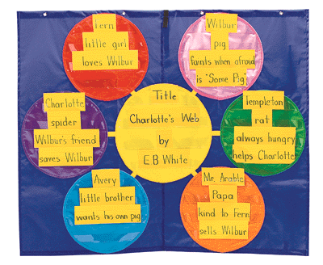
Beneficial Technology
Graphic Organizers:
Reduces or eliminates frustration by allowing students to visually organize their thoughts
May help improve writing or speech skills
Allows students to clearly identify connections between ideas
Helps students to edit their thoughts prior to writing them
http://www.myfreshplans.com/images/z103566796.gif
Example of a Graphic Organizer

Slide 10
References
Heward, William L. Exceptional Children: An Introduction to Special Education. Ninth ed. Columbus, Ohio: Pearson, 2007. Print.
Siegfried, Othmer. "The Story of Brian." The Brian Othmer Foundation. N.p., n.d. Web. 13 May 2011. http://www.brianothmerfoundation.org/brianstory.htm.
Simpson, Richard L., Peterson, Reece L., Smith, Carl R. Critical Educational Program Components for Students with Emotional and Behavioral Disorders: Science, Policy, and Practice. Remedial & Special Education. Vol. 32 Issue 3, p230-242. May2011.

