Slide 1
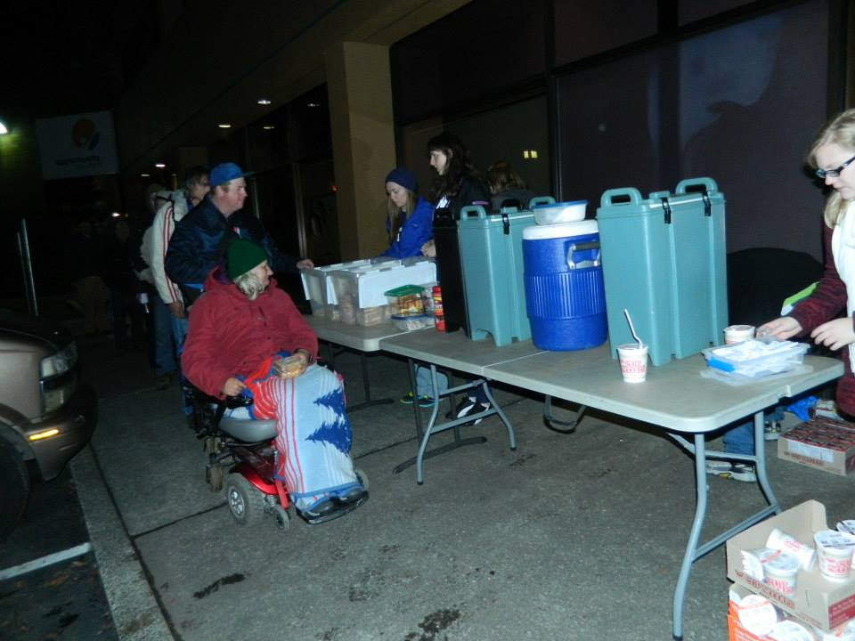
Community Engaged Project
Presented by Lauren Milne

Slide 2
Community Partner: CAST

Slide 3
Rationale for Change
This winter (2014), the street ministry, CAST, was almost discontinued.
Some felt that they were wasting space that more successful organizations could utilize.
Still, others were not ready to give up…

Slide 4
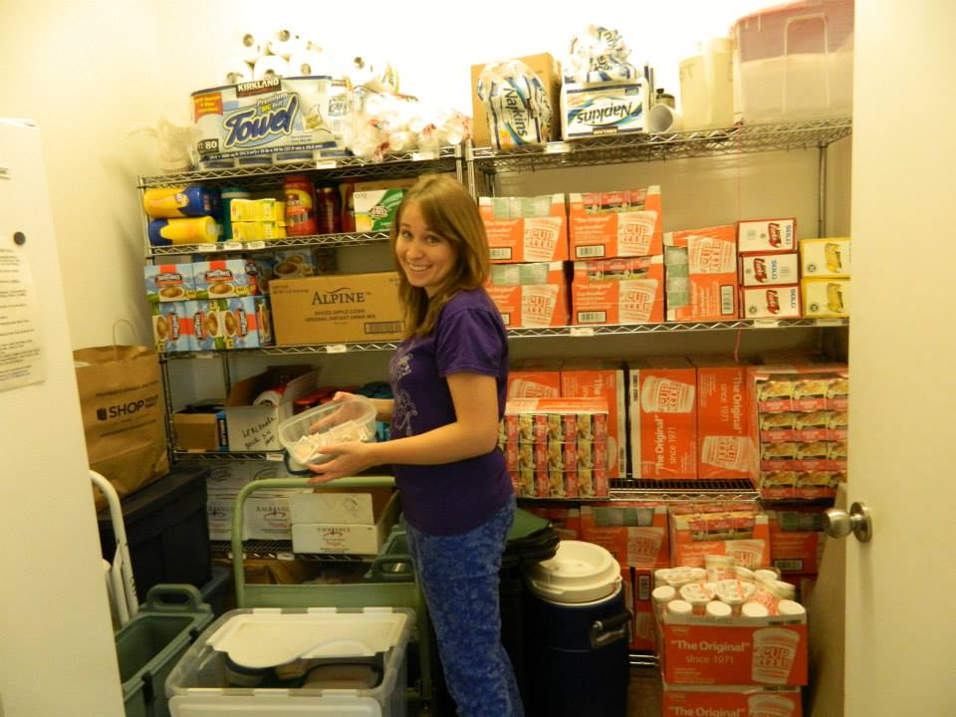
Sometimes we’re ok…Other times, not so much

Slide 5
The Case Against Terminating CAST:
There has never been a day when no one showed up for food or supplies
Not all of the individuals we serve like big crowds – they prefer smaller operations such as CAST
Our existence helps in documenting the needs of the homeless through events like Homeless Connect and data collected monthly via Volunteer Center

Slide 6
Efforts to Enact Change
During a meeting with Mary Ann O’Hara, CAST’s lead, we discussed several issues brought up by the very population we serve.
With all the volunteers present, we then had a meeting on ideas for change to both strengthen (and empower) CAST’s presence.
Letter to businesses

Slide 7
Recommendations for the Community’s Future Development
Communication Log
Needs
Concerns
Praises
Regular Volunteer Meetings
Push for Food Handler’s Permits From All Volunteer Coordinators

