Slide 1
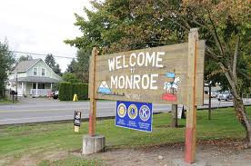
How Do Communities Change Over Time?

Slide 2
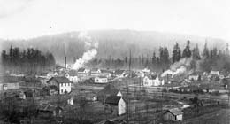
Monroe, 1903

Slide 3
Facts about old Monroe
The town is located at the bottom of a river valley
Monroe became a town in 1903
The town was founded by loggers
When it became a town it only had 300 citizens!
People traveled to Monroe on the Great Northern Railway

Slide 4
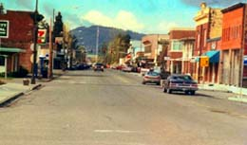
Monroe, 1990s

Slide 5
Facts about Monroe in the 1990s
The town only had one stop light!
There were dairy farms everywhere
4,275 people lived in Monroe
People traveled to Monroe using SR-2 and I-405

Slide 6
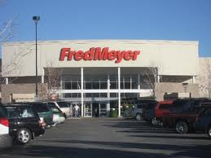
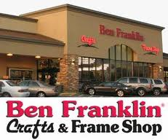
Current Monroe

Slide 7
Facts about new Monroe
17,305 people live here
Most of the dairy farms are gone
The Evergreen State Fair holds Nascar races
We now have 8 stop lights

Slide 8
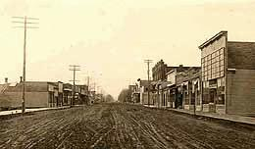
Lynden, 1900

Slide 9
Facts about old Lynden
The town is located in a river valley
Lynden became a town in 1891
Began as a logging town
There were 600 to 700 people living in Lynden at the time

Slide 10
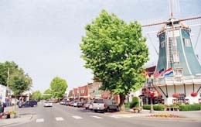
current Lynden

Slide 11
Facts about current Lynden
11,951 people live in Lynden today
Home to Washington state’s largest Dutch community
Most farms are dairy or berry farms
People travel to Lynden using SR-539
Lynden celebrates “Holland Days”

Slide 12
So, tell me class, how are Lynden and Monroe the same? How are they different?
Think about the type of land, why the town’s were founded, and different activities you can find in both towns.

Slide 13
Same or Different?
Lynden
Monroe
Founded by miners and loggers.
People use to travel here on wagons.
Now people use freeways.
Lynden grows dairy and berries.
Here, people celebrate “Holland Days”
Founded by miners.
People used to travel here by train.
Now people use highways and freeways.
Monroe grows dairy goods.
Here, people watch Nascar races.

